Slide 1
Data Visualization
2-PSK, 4-PSK, 16-QAM

Slide 2
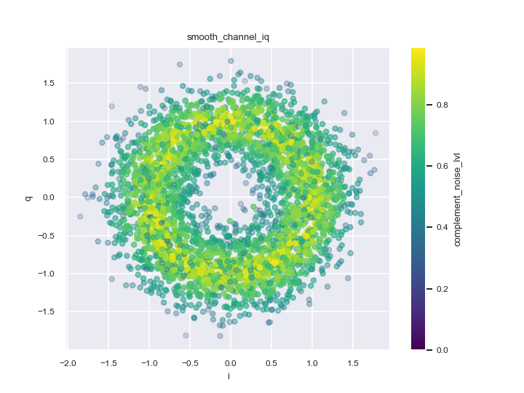
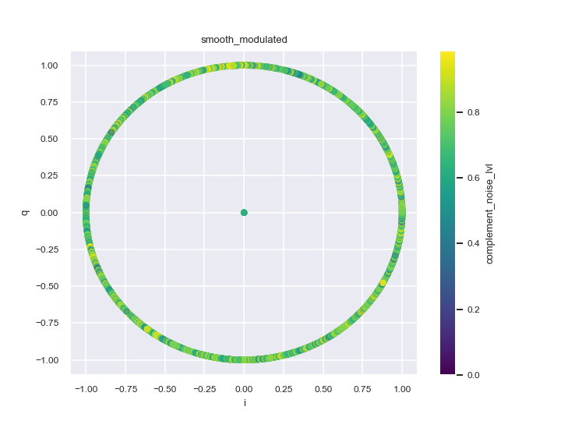
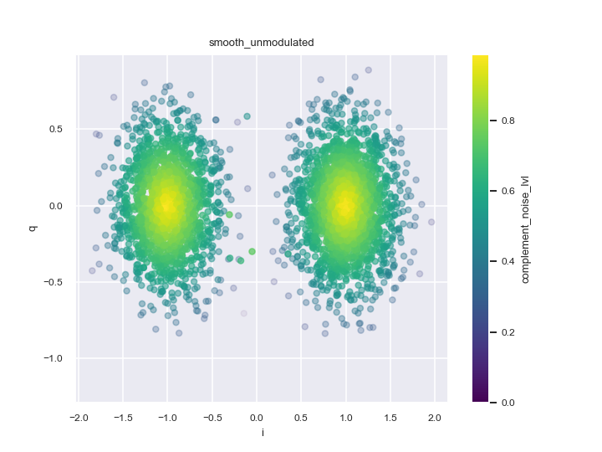
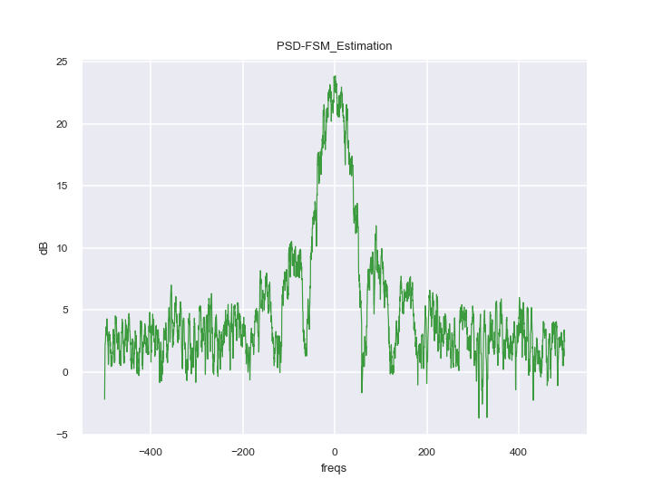

2-PSK
Noise:
$Ν ∼(μ=0, σ=0.4)$
Message Length
3216
Baseband Carrier frequency
1
Pulse Shaping
Rectangular

Slide 3
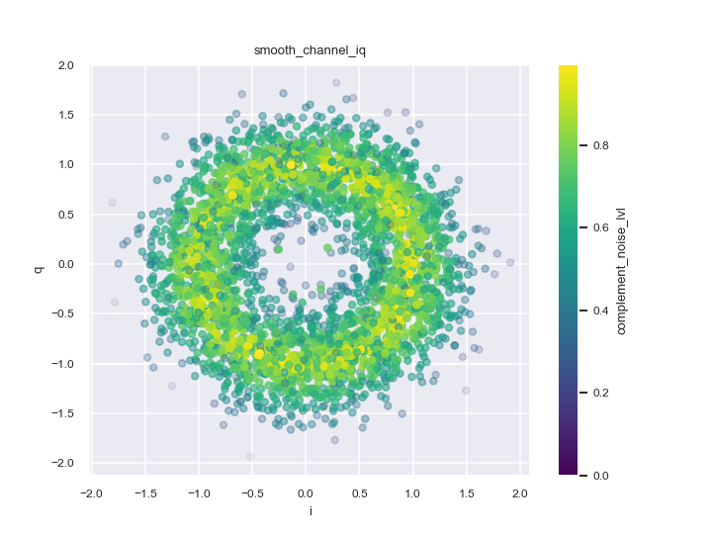

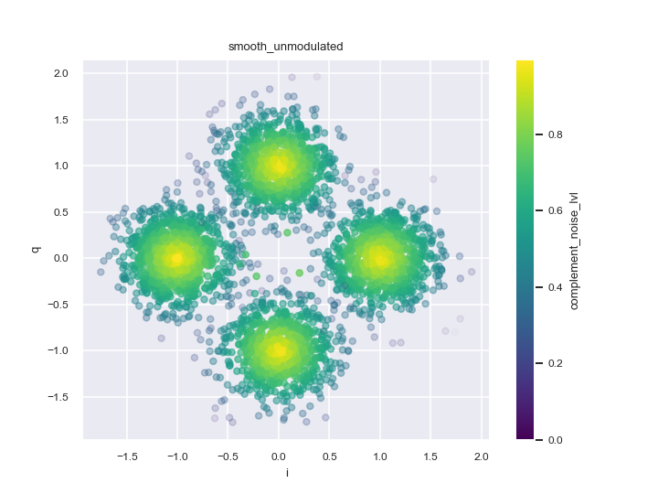
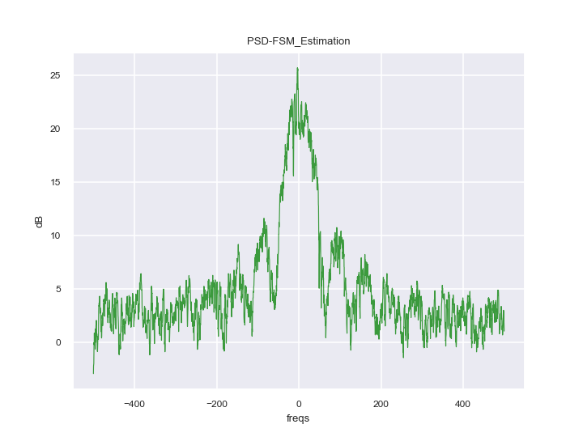
4-PSK
Noise:
$Ν ∼(μ=0, σ=0.4)$
Message Length
3216
Baseband Carrier frequency
1
Pulse Shaping
Rectangular

Slide 4
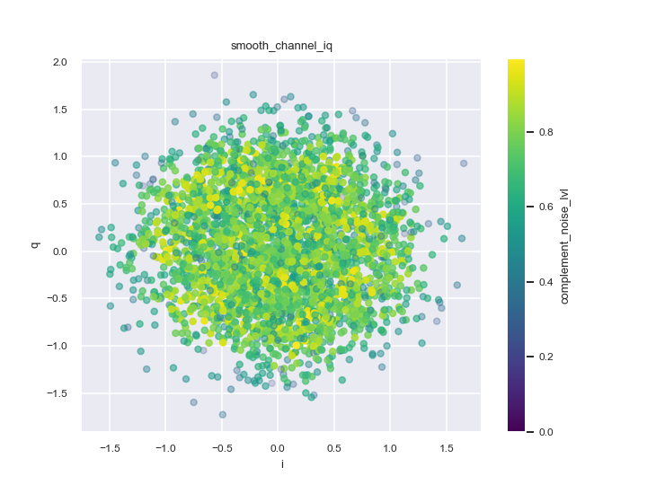
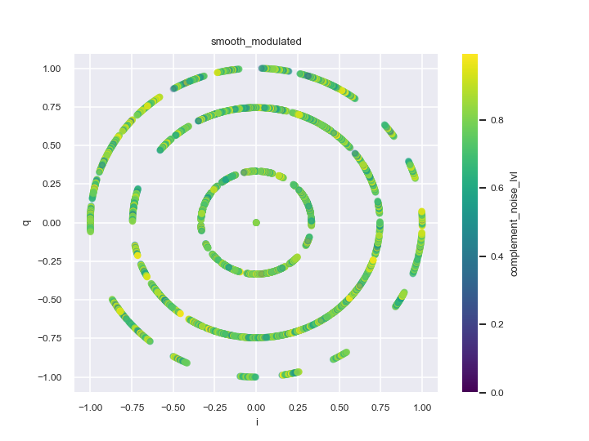
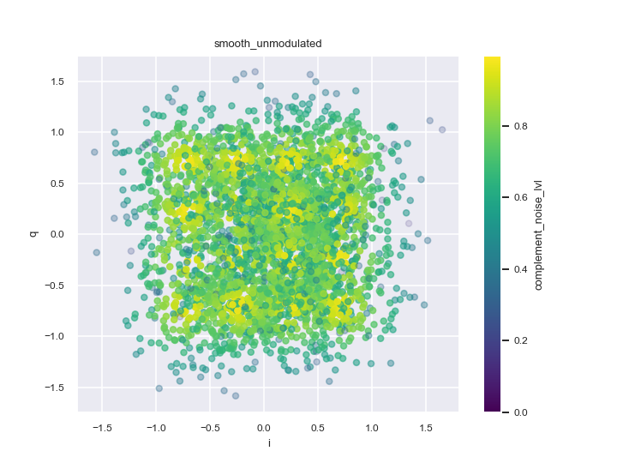
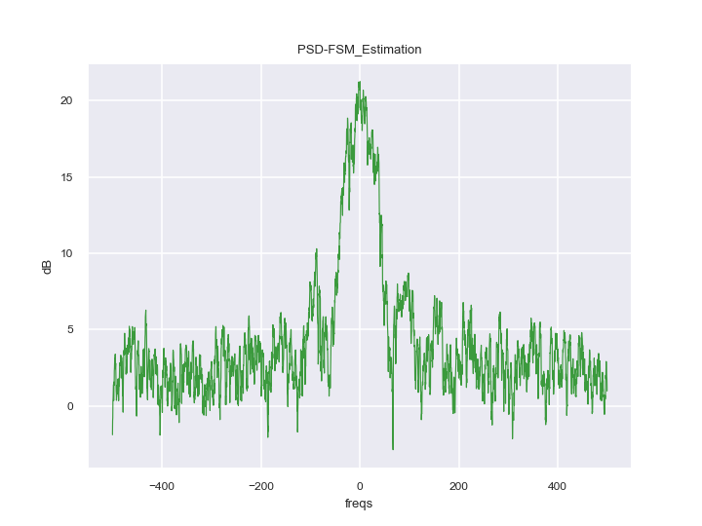
16-QAM
Noise:
$Ν ∼(μ=0, σ=0.4)$
Message Length
3216
Baseband Carrier frequency
1
Pulse Shaping
Rectangular

Slide 5
2nd Order Cyclostationary Statistics Spectral Correlation Function
…

